Slide 1
Course - DT228/1
Information Technology Fundamentals
A HISTORY OF INFORMATION TECHNOLOGY

Slide 2
What Sort of History?
For the context of this module (Information Technology Fundamentals) I have chosen to look at developments in hardware – the ‘four generations’ of development.
This includes:
Vacuum tube technology
Magnetic core technology and transistors
Integrated circuits

Slide 3
What Sort of History? (2)
There is also a look at developments in IBM, Microsoft and Intel, comparing their fortunes since their early days.
This ought to give some insight into why PCs (as this part of the course module is Personal Computer-focused) became so ubiquitous.

Slide 4
Electrical Computers
Modern computers use electricity.
Electrical computing really began in the last year or two of the 1930s as experimental ‘adding machines’.
There began a history of computing that is usually viewed in stages.

Slide 5
Generations of Hardware
There are four generations of computer hardware - and some say we are in the midst of the fifth generation of hardware development.
World War 2 was a time of heavy investment in technology – speeding up development of computing machines.

Slide 6
First Generation
Vacuum Tube Technology (1946 – 1956)
The first generation of computers relied on vacuum tubes to store and process information.
These tubes consumed a great deal of power, were short-lived and generated a great deal of heat.
They were huge machines - but had limited memory and processing capability and were used for very limited scientific and engineering work.

Slide 7

Vacuum Tubes
First Generation electronic computers used vacuum tubes.
Vacuum tubes are glass tubes with circuits inside.
Vacuum tubes have no air inside of them, which protects the circuitry.

Slide 8
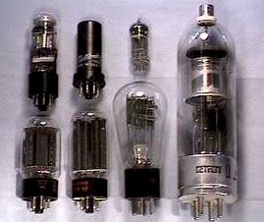
Vacuum Tubes (2)
Vacuum Tubes

Slide 9
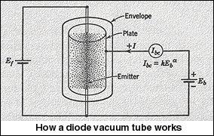
Vacuum Tubes (3)

Slide 10
Vacuum Tubes (4)
A vacuum tube is a glass tube surrounding a vacuum (an area from which all gases have been removed).
When electrical contacts are put on the ‘in-point’ and ‘out-point’ you can get a current to flow though the vacuum inside the glass.

Slide 11
First Generation (continued)
Thomas Edison, in 1883, while experimenting with lightbulbs, saw that he could get current to jump from the hot filament to a metal plate underneath the filament.
Edison’s discovery - the "Edison effect" - was that electrical current does not need a wire to move through. It can travel right through a gas or even a vacuum.
It was many years later (during the 1930s) that the vacuum tubes (also known as valves) were used practically in computing devices.

Slide 12
First Generation (cont (2))
Main memory size was typically 2000 bytes (2 K bytes).
Speed was about 10,000 instructions per second.
Rotating magnetic drums were used for internal storage and punched cards were an external storage medium.
Jobs such as running programs or printing output had to be controlled manually.

Slide 13
Second Generation
Transistors (1957 – 1963)
These had transistors instead of vacuum tubes as the devices for storing and processing information.
Transistors
were much more stable,
more reliable than vacuum tubes,
they generated less heat,
consumed less power.
Each transistor had to be individually made and wired into a printed circuit board.

Slide 14
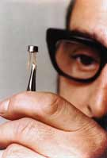
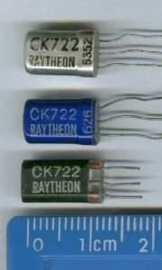
Second Generation (2)
A transistor (being examined by a bloke with tweezers) | Junction transistors

Slide 15
Transistors used in 1950s computers were a kind of semiconductor amplifier, because when a bit of electrical current came through one of the contacts (inward), another even stronger current came out of the other contact.
Transistors could (can) either let lots of current through or let none through.

Slide 16
Second Generation (3)
Magnetic core memory was the primary storage technology of this period - small magnetic rings, about 1mm in diameter.
Each ring could be polarised in one of two directions to represent a data bit.
Wires were strung along and through these cores to both write and read data. This system had to be assembled by hand and was, therefore, very expensive.

Slide 17
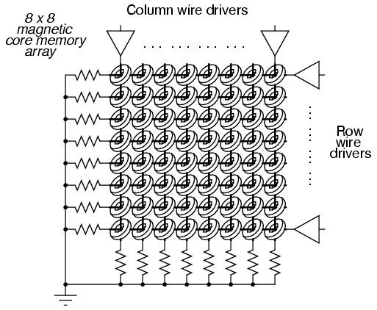
Ferrite ring core memory diagram (These rings are about ten times the actual size!)
Each of these rings ‘held’ magnetism polarized in one direction or the other to represent a Binary 1 or 0.

Slide 18
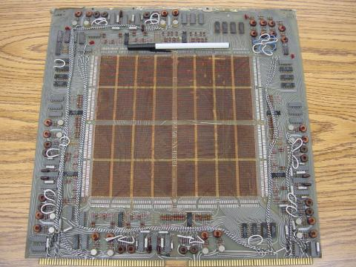
Ferrite ring core memory board (Circa late 1950s)

Slide 19
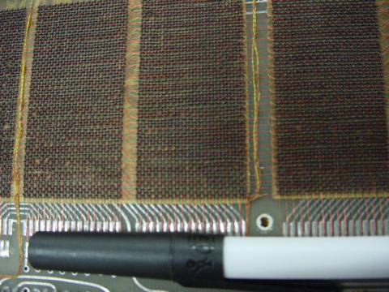
Close-up of a ferrite ring core memory board

Slide 20
Second Generation (4)
Second generation computers had up to 32K bytes of random access memory.
Speeds of 200,000 - 300,000 instructions per second.
They were used more widely for scientific work and for business tasks such as automating payroll and billing.

Slide 21
Third Generation
Integrated Circuits (1964 – 1979)
These used integrated circuits that were made by printing hundreds, later thousands of tiny transistors on small silicon chips.
These devices were called semiconductors.
Computer memories expanded to 2,097,152 bytes (2 Megabytes) of Random Access Memory (RAM). (2 x 2 to the 20th power.) Speeds went to 5 million instructions per second (5 MIPS).

Slide 22
Third Generation (2)
Special software - operating systems were needed. They automated the running of the programs and communications between the Central Processing Unit, printers and other output and input devices.
With 3rd Generation computers came software which could be used by people without extensive technical training, making it possible to expand computers’ role in business.

Slide 23
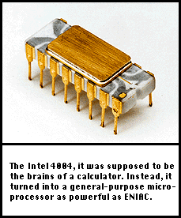
Third Generation (3)
Around 1971
The 4004 had 2,250 transistors
four-bit chunks (four 1’s or 0’s)
108Khz clock speed
Was called a “Microchip”

Slide 24
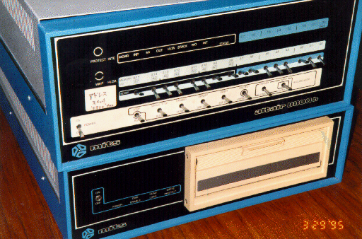
Third Generation (4)
1975, MITS Altair
256 byte memory (not Kilobytes or Megabytes)
2 MHz Intel 8080 chips
Just a box with flashing lights
Cost : $395 kit, $495 assembled.
MITS – Micro Instrumentation and Telemetry Systems, Inc.

Slide 25
Fourth Generation
Very Large-Scale Integrated Circuits (1980 – Present)
These use very large-scale integrated circuits (VLSIC) may have typical speeds exceeding 200 MIPS.
Such Integrated Circuits (ICs) are packed with 200,000 to over 3,000,000 circuits per chip. (Example: Pentium III = @ nine million transistor-type circuits.)

Slide 26
Fourth Generation (2)
Costs have fallen so that desktop computers are relatively inexpensive and available for use in business and everyday life.
Memory capacity has gone to around four billion bytes (4 gigabytes) in standard PC machines.
‘Intelligent’ electronic features of cars, stereos, toys, cameras and watches, for instance, are based on microprocessors.

Slide 27
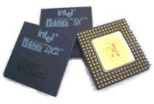
Intel 80486 microchips
A ‘486’ (of @ 1990) had two million transistors on the circuit. The equivalent of 2,000,000 vacuum tubes. The most modern chips have, typically, seven million transistors.

Slide 28
Generations of Electronic Computers
First
Second
Third
Fourth Gen.
Generation
Generation.
Generation.
Technology
Vacuum
Transistors
Integrated
Microchips
Tubes
Circuits
(millions of
(multiple
transistors)
transistors)
Size
Filled Whole
Filled half a
Smaller
G4 smart phone
-
Buildings
room
is as
power
ful as
old building
sized computer

Slide 29
Evolution of Electronics
Microchip (VLSIC)
Integrated Circuit
Transistor
Vacuum Tube
Capacity (and efficiency)

Slide 30
PC Chips
The series of personal computer ‘chips’ were:
8086 (‘The 86’)
80286 (‘The 286’)
80386 (‘The 386’)
80486 (‘The 486’)
Pentium
Pentium II
Pentium III
Pentium 4
After that there were various others - Celeron, Celeron D, Pentium M, Dual Core and Quad Core…

Slide 31
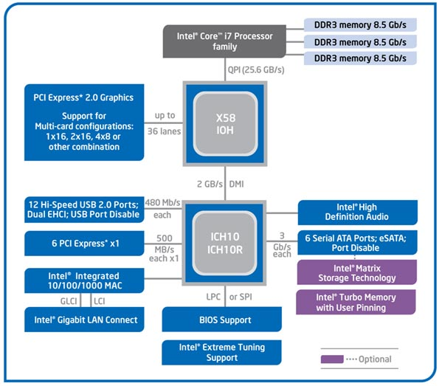
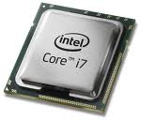
PC Chips (2)
The new and super Intel i7 processor
A ‘simple’ diagram of the 2-core version
31
Notes:
31

Slide 32
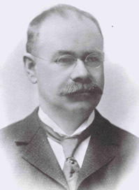
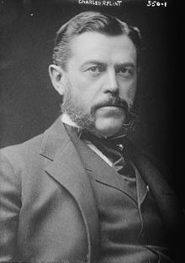
International Business Machines
Herman Hollerith set up a company called the ‘Tabulating Machine Company’ for his census-tabulating work for the US Census Office (around 1896).
Businessman Charles Flint brought together four administrative services companies including:
Computing Scale Company
Tabulating Machine Company (Hollerith’s company)
International Time Recording Company
Bundy Manufacturing Company
to make up the Computing-Tabulating-Recording Company (C-T-R) (around 1911).
Herman Hollerith
Charles Ranlett Flint

Slide 33
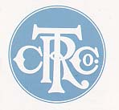
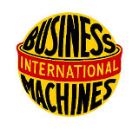
International Business Machines (2)
Thomas J. Watson was president of
C-T-R.
Watson renamed C-T-R as ‘International Business Machines’ (around 1924).
The ‘IBM’ name had been used by the C-T-R business since 1917 in Canada.

Slide 34
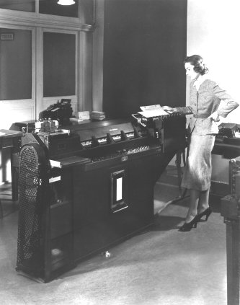
IBM Development
In 1924 IBM was based in New York state but had three European operations.
IBM was involved in providing machines for business such as the ‘Type 285 Numeric Printing Tabulator.’
(1927 -1933 (either, depending
on your source)).

Slide 35
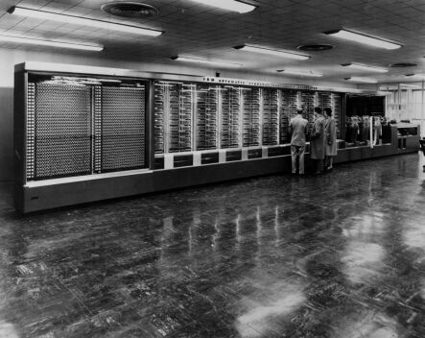
IBM Development (2)
The IBM Automatic Sequence Controlled Calculator.
This machine was placed in Harvard University in 1944 and could add, subtract, multiply and divide decimal numbers (up to 23 places in length).

Slide 36
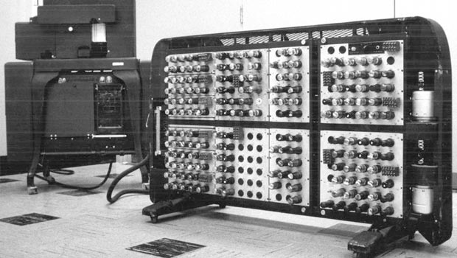
IBM Development (3)
The IBM Automatic Sequence Controlled Calculator.
A closer look at its components:

Slide 37
IBM Development (4)
There were constant developments in IBM, in terms of machinery improvements, from 1924 onwards, but there were a few IBM ‘landmark’ computers.
Examples are:
IBM 701 (Defense Calculator)
System /360
AS 400
IBM PC (Personal Computer)

Slide 38
IBM 701 Defense Calculator
The first of IBM’s mass-produced large-scale electronic computer (19 made) and the company’s first commercially available scientific computer.
The first IBM machine in which programs were stored in an internal, addressable, electronic memory.
This machine was IBM's move from punched-card machines to electronic computers.

Slide 39
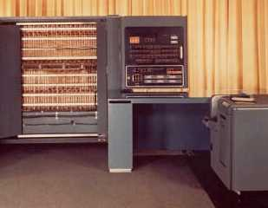
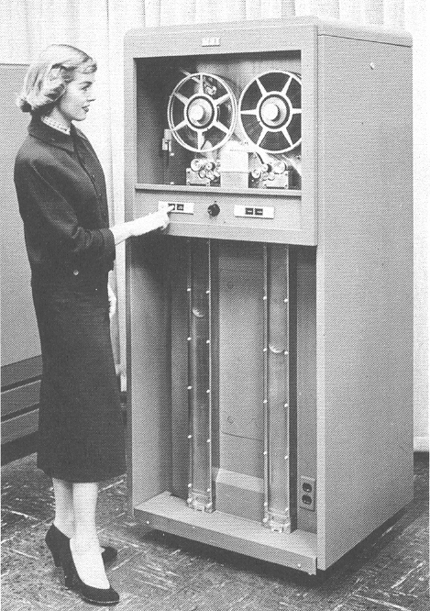
IBM 701 Defense Calculator (2)
First installed in 1952
Addition time:
60 microseconds
Multiplication:
456 microseconds
Memory:
2048 (36 bit) words using Williams tubes
(See tutorial)
Secondary memory:
Magnetic drum: 8192 words (See tutorial)
Magnetic tape: magnetic reels of plastic tape

Slide 40
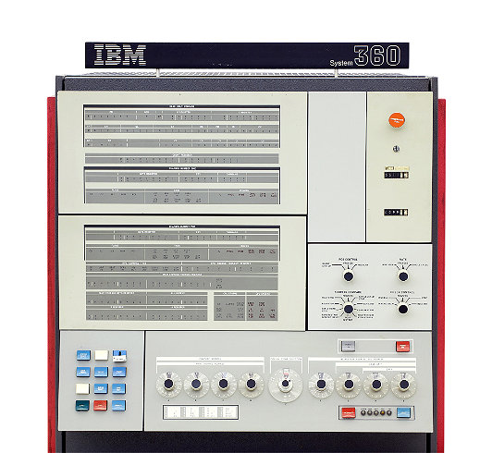
System /360
April 1964 IBM announces the System/360
Using ‘Solid Logic Technology’ (integrated circuits)
There were 5 types – a family of ‘compatible’ computers
Instructions were performed in nanoseconds.

Slide 41
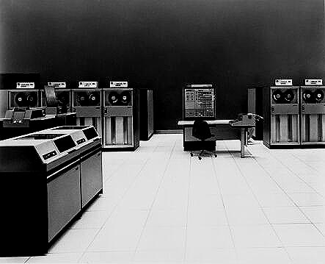
System /360 (2)
This was a Third Generation machine and a mainframe.
It had two options for operating system –
Basic Operating System 360 (BOS/360) and
Operating System 360 (OS/360).

Slide 42
System /360 (3)
The 360 was innovative in that it was modular.
Unlike earlier computers it was not a monolithic design, but consisted of modules that could be fitted together to construct a family of computers that would meet the needs of companies and organisations of any size.
So IBM was presenting itself as being responsive to customer needs.

Slide 43
AS/400
In 1988 IBM launched the Application System/400.
A mid-range business computer – or a family of midrange business computers. The B-Series had 6 types (see next slide).
The selling point for this machine was that it could run ‘hundreds’ of applications.
It has often been recommended as a network server – a single computer managing numerous users on a network.

Slide 44
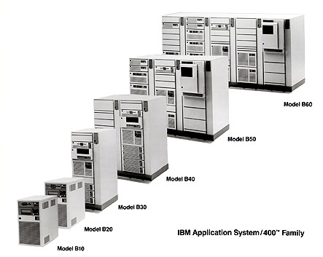
AS/400 (2)
From around 1988
Operating System:
OS/400
Used for
Data warehousing
Java application development
Web and e-commerce serving
Corporate groupware

Slide 45
IBM PCs (Personal Computers)
To go BACK a few years:
During 1979 some computer companies were developing computers that could be used in the office of businesses – not just large corporations, but small single-office set-ups – and maybe even the home.
The computer company Apple were on this as a new product, for example.

Slide 46
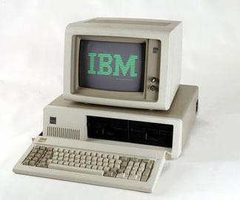
IBM PCs (2)
By the early 1980s it was easy to build and design desktop machines since the microprocessor had become available, and many manufacturers were already shipping personal computers, such as:
Commodore
Atari
Apple
Tandy

Slide 47
IBM PCs (3)
IBM wished to enter the personal computer market, and to do so, in 1981 they repeated some of the innovations of the 360 when they introduced the PC.
The PC was, as much as possible, designed and manufactured using open standards, and using off-the-shelf components.
This meant that the machine was designed quickly. From beginning to end of the design took just one year.

Slide 48
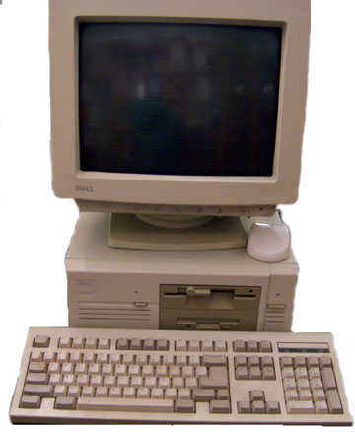
IBM PCs (4)
The open design of the PC ensured that manufacturers could produce components for the PC, thus making it more versatile.
It also meant that other manufacturers could build their own competing computers.
These competitors included Amstrad, Compaq, and Dell.
Dell around 1985

Slide 49
IBM Today
Today IBM manufactures and sells a vast range of products and services, including hardware:
storage products
point-of-sale equipment
servers
and software:
databases
office productivity suites
cloud software

Slide 50
Microsoft
During its entire foray into the computing field IBM was always a corporate entity, and one would think that only another corporate entity could compete successfully with it.
Microsoft can tell the tale of how individuals could challenge the might of IBM.

Slide 51
Microsoft (2)
In 1975 Micro Instrumentation and Telemetry Systems (MITS) released the Altair 8800 microcomputer.
Paul Allen and Bill Gates developed a BASIC interpreter for the machine which they sold to Altair.
Interestingly, while they were developing the interpreter they did not have the appropriate hardware, so while Gates wrote the interpreter Allen was busy writing a simulator on which the interpreter could run.

Slide 52
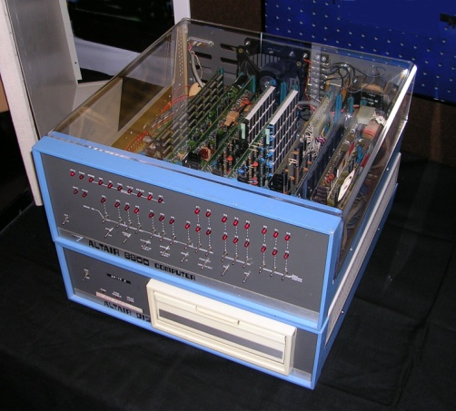
Microsoft (3)
Altair purchased Gates and Allen's interpreter and sold it as Altair BASIC.
In 1975 Microsoft was founded.
In 1980 Microsoft released its own version of Unix - Xenix.
Mid-70’s Altair 8800

Slide 53
Microsoft (4)
When the IBM PC was being developed in 1981 IBM needed an operating system (OS) for it and wanted to use a version of the then dominant operating system - CP/M - which was owned by Digital Research. (CP/M = Control Program for Microcomputers)
Digital Research decided against entering into an agreement with IBM and the contract for developing an OS was awarded to Microsoft.

Slide 54
Microsoft and DOS
Unfortunately Microsoft didn't have a suitable OS, so they bought a CP/M clone called 86-DOS from Seattle Computer Products and renamed it MS-DOS. (DOS = Disk Operating System)
IBM rebranded MS-DOS as PC-DOS on their PCs but allowed Microsoft to retain the copyright (thinking it would not last as a valuable OS).
MS-DOS was the OS used on IBM PC clones.

Slide 55
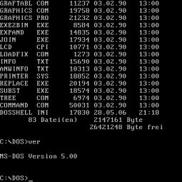
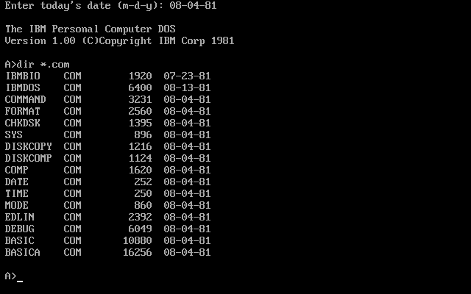


Microsoft and DOS (2)
So Microsoft earned money both from IBM, for PC-DOS, and more money from IBM competitors for MS-DOS.
Now that’s proper marketing!

Slide 56
IBM and Microsoft
DOS had a problem in that it was purely a text based OS, whereas Steve Jobs’ company, Apple had released a computer with a graphical user interface (GUI).
IBM and Microsoft agreed to cooperate to produce their own GUI. This was to be known as OS/2. OS/2 developed very slowly - particularly Microsoft's part of the work...
... and while all this was going on Microsoft released Windows. (@ end of 1986, early 1987)

Slide 57
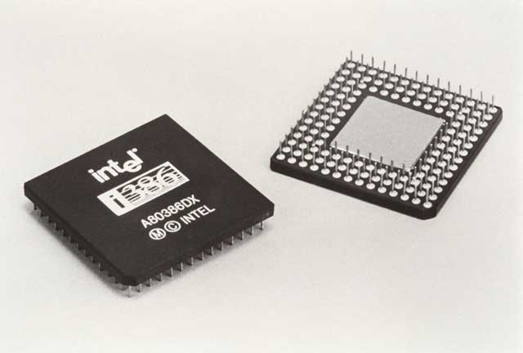
IBM and Microsoft (2)
OS/2 and the early versions of Windows were actually quite similar in many respects, and in fact, shared much of the same code.
However, IBM wanted to continue support for the 80286 processor, whereas Microsoft wanted to develop for the 80386.
IBM continued support and development of OS/2 Versions 1 and 2, while Microsoft took control of OS/2 Version 3.

Slide 58
Microsoft – Windows NT
Microsoft hired Dave Cutler in 1988 to continue to develop OS/2, but he redesigned it completely. The resultant operating system became Windows NT.
Windows NT competed against IBM's OS/2 but since it was designed for better hardware its performance was far superior.
Windows, from ‘little’ Microsoft, quickly became the dominant operating system for PCs.

Slide 59
Microsoft Windows
Developing an operating system gives one a competitive advantage when producing other software.
When writing software one needs APIs (Application Programming Interface) - hooks to the operating system - but some of these only Microsoft knew about.
So Microsoft’s own applications could run faster and using less resources than applications from other software developer companies that were designed to run on Windows.

Slide 60
Microsoft (Allegations Against)
Over the years Microsoft has been involved in several anti-trust cases (law suits) with application software providers.
It was alleged that the distribution of various applications such as Internet Explorer with Windows was unfair competition to competitors such as Opera and Mozilla.
It was alleged that they formed restrictive licensing agreements with original equipment manufacturers (OEMs).

Slide 61
Intel
A software company can be started in a bedroom or a garage with very little capital.
Hardware companies require a lot more capital.
Intel was founded in 1968 by Gordon E. Moore and Robert Noyce with Arthur Rock as an investor. (Arthur Rock was a backer for many tech companies – including Apple.) The original investment was $2.5 million.

Slide 62
Intel (2)
Intel's main attribute was innovation.
Both of the employees were physicists, and Noyce was the co-inventor of the integrated circuit.
Both were former employees of Fairchild Semiconductors.
Initially Intel concentrated on the manufacture of memory chips.

Slide 63
Intel (3)
Intel were asked by Busicom to produce a set of 12 specialised chips for a calculator it had designed.
Instead Intel designed a single-chip general purpose device which later became the 4004, the world's first commercially available microprocessor.
When Japanese manufacturers began manufacturing memory chips Intel began concentrating on microprocessors.

Slide 64
Intel Microprocessors
Intel developed its microprocessor manufacture and produced the
4004 (1971)
8008 (1972)
8080 (1974)
8086 (1978)
And here they had some luck. The 8086's little brother, the 8088 was chosen by IBM for its PC. (1979 or 1980)

Slide 65
Intel Microprocessors (2)
Intel has continued to innovate. Following the 8086 were the
80186 (1982)
80286 (1982)
80386 (1985)
80486 (1989)
Pentium (1993)
and later multi core CPUs

Slide 66
Intel Today
Intel is successful mainly because of its innovation.
It also has the advantage that because of its large size it is very hard to compete with. It takes a team of several thousand people to design and produce a modern microprocessor, so any start-up companies immediately have a very stiff challenge.

Slide 67
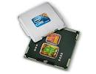
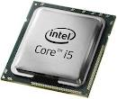
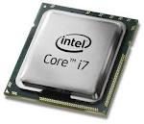
Intel Today (2)
The current mainstay of Intel microchips are Core i3, i5 and i7 (multicore processors).
i3 – 2 cores
i5 – 4 cores
i7 – 4 cores
Their first chip, around 1971 had 2,300 transistors on it.
The new Core i7 has, typically, more than 731 million transistors on it (or attached to it).

Slide 68
Up Next
Next week’s lecture title is:
Technology for Problem-Solving

